Slide 1
Basic SQL

Slide 2
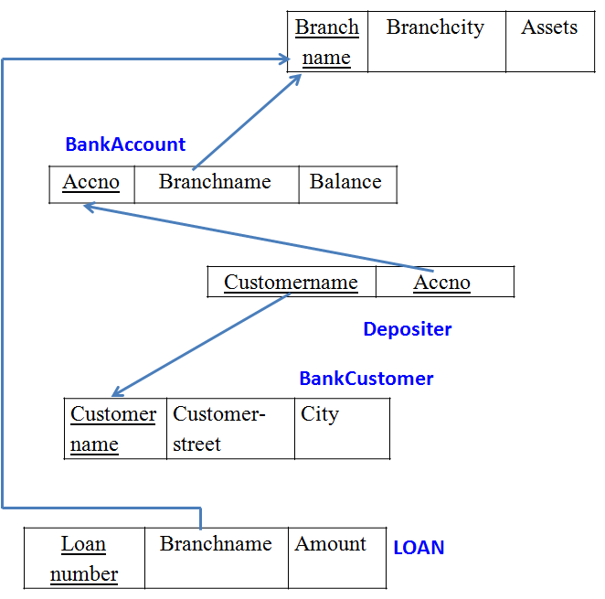
Relational Schema

Slide 3
SQL
SQL stands for Structured Query Language. It is used for storing and managing data in relational database management system (RDBMS).
It is a standard language for Relational Database System. It enables a user to create, read, update and delete relational databases and tables.
All the RDBMS like MySQL, Informix, Oracle, MS Access and SQL Server use SQL as their standard database language.
SQL allows users to query the database in a number of ways, using English-like statements

Slide 4
SQL Commands
There are five types of SQL commands: DDL, DML, DCL, TCL, and DQL.
Data Definition Language (DDL)
Data Manipulation Language(DML)
Data Control Language (DCL)
Transaction Control Language (TCL)
Data Query Language (DQL)

Slide 5
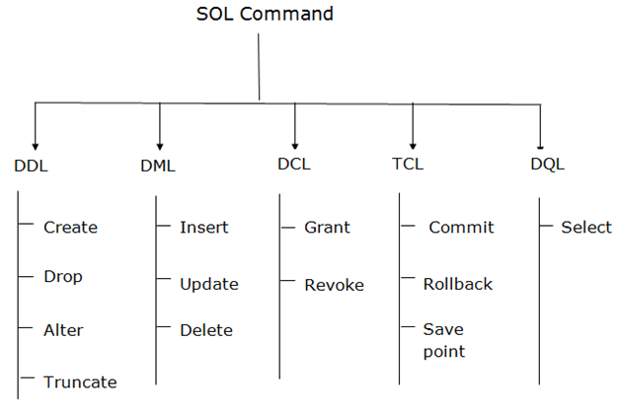
SQL Commands

Slide 6
Basic SQL
Structured Query Language
Considered one of the major reasons for the commercial success of relational databases
Terminology:
Relational Model | SQL
relation | table
tuple | row
attribute | column
Syntax notes:
SQL is not case-sensitive.

Slide 7
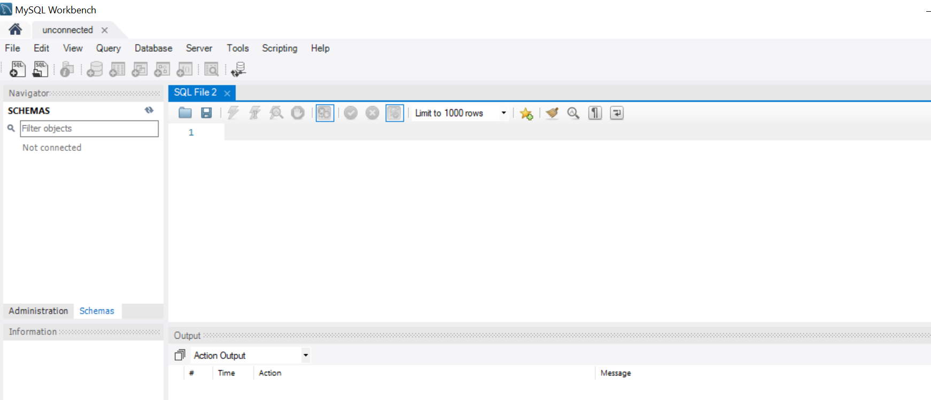
Mysql workbench

Slide 8
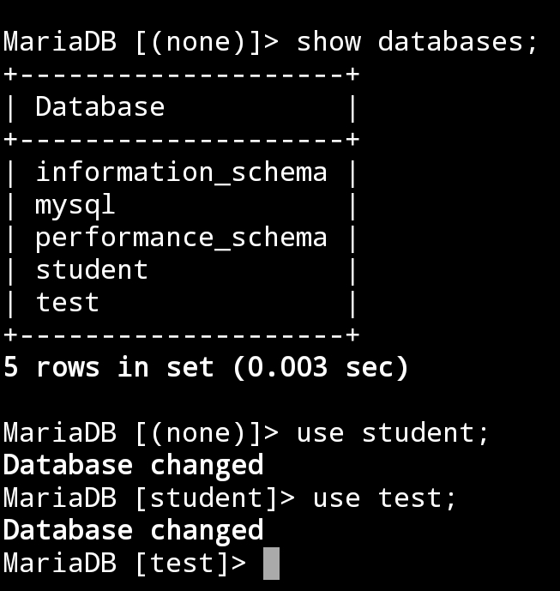
SQL Command
List all the existing databases
Show databases;
To use existing database
Use databasename;

Slide 9
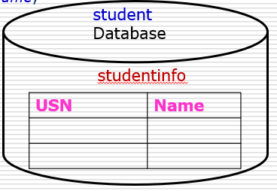
SQL Create Command
create is a DDL (Data Definition) command used to create a table or a database.
Creating a Database
Syntax: create database database-name;
Example: create database student;
Creating a Table
Syntax:
create table table-name (
column-name1 datatype1,
column-name2 datatype2 );
Example:
create table studentinfo(
USN char(10),
Name char(30)
);

Slide 10
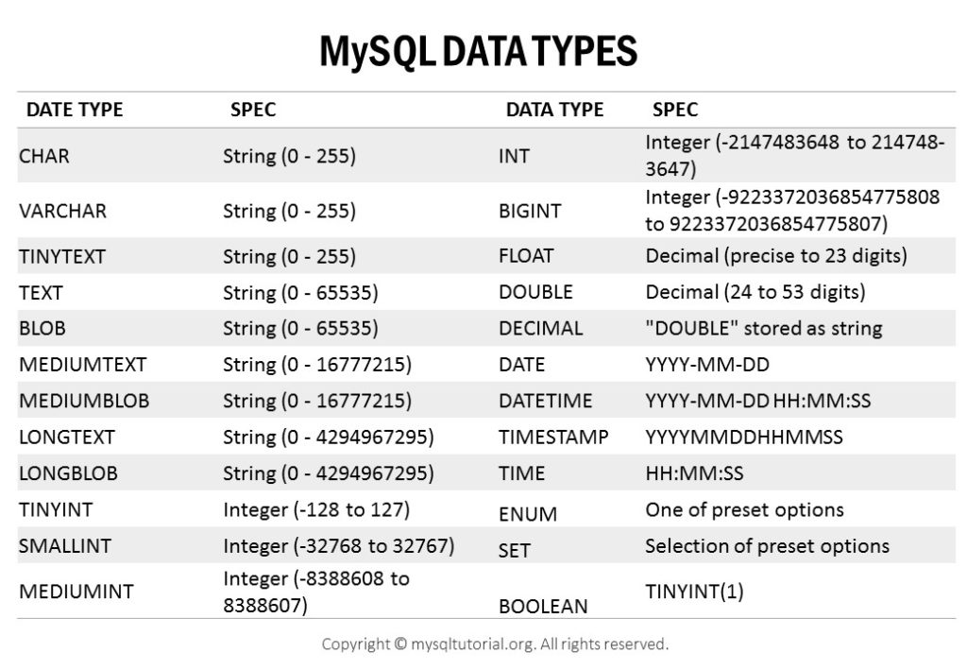

Slide 11
SQL Constraints
SQL constraints are used to specify rules for the data in a table
If there is any violation between the constraint and the data action, the action is aborted.
Constraints can be specified when the table is created with the CREATE TABLE statement, or after the table is created with the ALTER TABLE statement.
Constraints can be column level or table level.
CREATE TABLE table_name ( column1 datatype constraint, column2 datatype constraint, column3 datatype constraint, .... );

Slide 12
SQL Constraints
The following constraints are commonly used in SQL
NOT NULL - Ensures that a column cannot have a NULL value
UNIQUE - Ensures that all values in a column are different
PRIMARY KEY - A combination of a NOT NULL and UNIQUE. Uniquely identifies each row in a table
FOREIGN KEY - Uniquely identifies a row/record in another table
CHECK - Ensures that all values in a column satisfies a specific condition
DEFAULT - Sets a default value for a column when no value is specified
INDEX - Used to create and retrieve data from the database very quickly

Slide 13
Specifying Attributes constraints and Attribute values
CREATE TABLE Persons ( ID int NOT NULL, LastName varchar(255) NOT NULL, FirstName varchar(255) NOT NULL, Age int );
create table stud(
USN char(10) UNIQUE NOT NULL,
Name char(30) NOT NULL,
DepName char(3) NOT NULL DEFAULT ‘CSE’,
Marks int NOT NULL CHECK (Marks > 0 AND Marks < 101));

Slide 14
Specifying Key and Referential Integrity constraints
PRIMARY KEY Constraint
The PRIMARY KEY constraint uniquely identifies each record in a table.
Primary keys must contain UNIQUE values, and cannot contain NULL values.
A table can have only ONE primary key; and in the table, this primary key can consist of single or multiple columns (fields).
CREATE TABLE Persons ( ID int NOT NULL, LastName varchar(255) , FirstName varchar(255) NOT NULL, Age int, PRIMARY KEY (ID) );

Slide 15
Specifying Key and Referential Integrity constraints
PRIMARY KEY Constraint
CREATE TABLE Persons ( ID int NOT NULL, LastName varchar(255) NOT NULL, FirstName varchar(255), Age int,
PRIMARY KEY (ID,LastName) );
ALTER TABLE Persons ADD PRIMARY KEY (ID);
ALTER TABLE Persons ADD CONSTRAINT PK_Person PRIMARY KEY (ID,LastName);

Slide 16
FOREIGN KEY Constraint
A FOREIGN KEY is a key used to link two tables together.
A FOREIGN KEY is a field (or collection of fields) in one table that refers to the PRIMARY KEY in another table.
The table containing the foreign key is called the child table, and the table containing the candidate key is called the referenced or parent table.

Slide 17
FOREIGN KEY Constraint
PersonID | LastName | FirstName | Age
1 | Hansen | Ola | 30
2 | Svendson | Tove | 23
3 | Pettersen | Kari | 20
OrderID | OrderNumber | PersonID
1 | 77895 | 3
2 | 44678 | 3
3 | 22456 | 2
4 | 24562 | 1
The "PersonID" column in the "Persons" table is the PRIMARY KEY in the "Persons" table.
The "PersonID" column in the "Orders" table is a FOREIGN KEY in the "Orders" table.
The FOREIGN KEY constraint is used to prevent actions that would destroy links between tables.
The FOREIGN KEY constraint also prevents invalid data from being inserted into the foreign key column, because it has to be one of the values contained in the table it points to.

Slide 18
FOREIGN KEY Constraint
PersonID | LastName | FirstName | Age
1 | Hansen | Ola | 30
2 | Svendson | Tove | 23
3 | Pettersen | Kari | 20
OrderID | OrderNumber | PersonID
1 | 77895 | 3
2 | 44678 | 3
3 | 22456 | 2
4 | 24562 | 1
CREATE TABLE Persons ( PersonID int NOT NULL, LastName varchar(255) NOT NULL, FirstName varchar(255), Age int, PRIMARY KEY (PersonID) );
CREATE TABLE Orders ( OrderID int NOT NULL, OrderNumber int NOT NULL, PersonID int, PRIMARY KEY (OrderID), FOREIGN KEY (PersonID) REFERENCES Persons(PersonID));

Slide 19
Insert command
The INSERT INTO statement is used to insert new records in a table
INSERT INTO table_name (column1, column2, column3, ...) VALUES (value1, value2, value3, ...);
OR
INSERT INTO table_name VALUES (value1, value2, value3, ...);
INSERT INTO studentinfo (USN, Name) VALUES (“1bm19cs001”, ”Kayal”);
(OR)
INSERT INTO studentinfo VALUES (“1bm19cs001”, ”Kayal”);

Slide 20
Insert command
Inserting multiple rows
Insert into table_name (col_name1,col_name2,….col_namen)
values (val1,val2,val3), (val1,val2,val3);
(OR)
Insert into table_name
values (val1,val2,val3), (val1,val2,val3);
Example
INSERT INTO studentinfo (USN, Name) VALUES (“1bm19cs001” ,”Kayal”), (“1bm19cs002” ,”Kavitha”);
(OR)
INSERT INTO studentinfo VALUES (“1bm19cs001” ,”Kayal”), (“1bm19cs002” ,”Kavitha”);

Slide 21
ALTER TABLE
The ALTER TABLE statement is used to add, delete, or modify columns in an existing table.
USN | Name
1 | Kayal
2 | Simon
3 | Smitha
ADD Column
ALTER TABLE table_name ADD column_name datatype;
ALTER TABLE studentinfo ADD Address varchar(40);

Slide 22
Alter table
DROP column -To delete a column in a table
ALTER TABLE table_name DROP COLUMN column_name;
ALTER TABLE studentinfo DROP COLUMN Address;

Slide 23
Alter table
MODIFY COLUMN - To change the data type of a column in a table
ALTER TABLE table_name MODIFY COLUMN column_name datatype;
ALTER TABLE table_name MODIFY COLUMN Address char(30);

Slide 24
Dropping table
The DROP TABLE statement is used to drop an existing table in a database.
The TRUNCATE TABLE statement is used to delete the data inside a table, but not the table itself.
DROP TABLE table_name;
Example
DROP TABLE studentinfo;
TRUNCATE TABLE table_name;
Example
TRUNCATE TABLE studentinfo;

Slide 25
Select Command
The SELECT statement is used to select data from a database.
The data returned is stored in a result table, called the result-set.
p table (parts) s table (suppliers)
pno | descr | color
P1 | Widget | Blue
P2 | Widget | Red
P3 | Dongle | Green
sno | name | city
S1 | Pierre | Paris
S2 | John | London
S3 | Mario | Rome
sp Table (suppliers & parts)
sno | pno | qty
S1 | P1 | NULL
S2 | P1 | 200
S3 | P1 | 1000
S3 | P2 | 200

Slide 26
Select Command
create table p (
pno varchar(10),
descr varchar(10),
color varchar(10),
PRIMARY KEY(pno)
);
create table sp (
sno varchar(10),
pno varchar(10),
Qty int ,
PRIMARY KEY(sno,pno),
FOREIGN KEY (sno) REFERENCES s(sno),
FOREIGN KEY (pno) REFERENCES p(pno)
);
create table s (
sno varchar(10),
name varchar(10),
city varchar(10),
PRIMARY KEY(sno)
);

Slide 27
SELECT
The SQL SELECT statement queries data from tables in the database
SELECT
FROM
WHERE
The SELECT clause specifies the table columns that are retrieved
The FROM clause specifies the tables accessed
The WHERE clause specifies which table rows are selected
The WHERE clause is optional; if missing, all table rows are selected

Slide 28
SELECT
SELECT name FROM s WHERE city='Rome’;
sno | name | city
S1 | Pierre | Paris
S2 | John | London
S3 | Mario | Rome
name
Mario

Slide 29

SELECT
p (parts table)
SELECT descr, color FROM p;
pno | descr | color
P1 | Widget | Blue
P2 | Widget | Red
P3 | Dongle | Green
(OR)
SELECT p.descr, p.color FROM p;
s (suppliers table)
SELECT name supplier, city location FROM s
sno | name | city
S1 | Pierre | Paris
S2 | John | London
S3 | Mario | Rome
supplier | location
Pierre | Paris
John | London
Mario | Rome

Slide 30
SELECT
SELECT * FROM sp
sno | pno | qty
S1 | P1 | NULL
S2 | P1 | 200
S3 | P1 | 1000
S3 | P2 | 200
s
sno | name | city
S1 | Pierre | Paris
S2 | John | London
S3 | Mario | Rome
SELECT sp.*, s.city
FROM sp, s
WHERE sp.sno=s.sno;
sno | pno | qty | city
S1 | P1 | NULL | Paris
S2 | P1 | 200 | London
S3 | P1 | 1000 | Rome
S3 | P2 | 200 | Rome

Slide 31
Where clause operators
> -- greater than
< -- less than
>= -- greater than or equal to
<= -- less than or equal to
<> -- not equal to
= --- equals
sno | pno | qty
S1 | P1 | NULL
S2 | P1 | 200
S3 | P1 | 1000
S3 | P2 | 200
SELECT * FROM sp WHERE qty >200
S3 | P1 | 1000

Slide 32
Operators
 | Operator & Description
1 | ALL The ALL operator is used to compare a value to all values in another value set.
2 | AND The AND operator allows the existence of multiple conditions in an SQL statement's WHERE clause.
3 | ANY The ANY operator is used to compare a value to any applicable value in the list as per the condition.
4 | BETWEEN The BETWEEN operator is used to search for values that are within a set of values, given the minimum value and the maximum value.
5 | EXISTS The EXISTS operator is used to search for the presence of a row in a specified table that meets a certain criterion.

Slide 33
OPERATORS
6 | IN Test if an expression matches any value in a list of values. The IN operator is a shorthand for multiple OR conditions.
7 | LIKE The LIKE operator is used to compare a value to similar values using wildcard operators.
8 | NOT The NOT operator reverses the meaning of the logical operator with which it is used. Eg: NOT EXISTS, NOT BETWEEN, NOT IN, etc. This is a negate operator.
9 | OR The OR operator is used to combine multiple conditions in an SQL statement's WHERE clause.
10 | IS NULL The NULL operator is used to compare a value with a NULL value.
11 | DISTINCT The UNIQUE operator searches every row of a specified table for uniqueness (no duplicates).

Slide 34
BETWEEN
BETWEEN Operator
The BETWEEN operator implements a range comparison
it tests whether a value is between two other values
SELECT *
FROM sp
WHERE qty BETWEEN 50 and 500;
sno | pno | qty
S1 | P1 | NULL
S2 | P1 | 200
S3 | P1 | 1000
S3 | P2 | 200
sno | pno | qty
S2 | P1 | 200
S3 | P2 | 200

Slide 35
NOT BETWEEN
NOT BETWEEN Operator
The BETWEEN operator implements a range comparison
it tests whether a value is between two other values
SELECT *
FROM sp
WHERE qty NOT BETWEEN 50 and 500;
sno | pno | qty
S3 | P1 | 1000

Slide 36
IN
IN Operator
The IN operator implements comparison to a list of values
it tests whether a value matches any value in a list of values
SELECT name
FROM s
WHERE city IN ('Rome','Paris’);
sno | name | city
S1 | Pierre | Paris
S2 | John | London
S3 | Mario | Rome
name
Pierre
Mario

Slide 37
NOT IN
NOT IN Operator
SELECT name
FROM s
WHERE city NOT IN ('Rome','Paris’);
sno | name | city
S1 | Pierre | Paris
S2 | John | London
S3 | Mario | Rome
name
John

Slide 38
Substring Pattern Matching: SQL LIKE Operator
The LIKE operator is used in a WHERE clause to search for a specified pattern in a column.
SQL LIKE Syntax
SELECT column_name(s)
FROM table_name
WHERE column_name LIKE pattern

Slide 39
SQL Wildcard Characters
In SQL, wildcard characters are used with the SQL LIKE operator.
SQL wildcards are used to search for data within a table.
With SQL, the wildcards are:
Wildcard | Description
% | A substitute for zero or more characters
_ | A substitute for a single character
Notes:
The pattern can contain special pattern-matching characters:
An underscore (_) in the pattern matches exactly one character
A percent sign (%) in the pattern can match zero or more characters

Slide 40
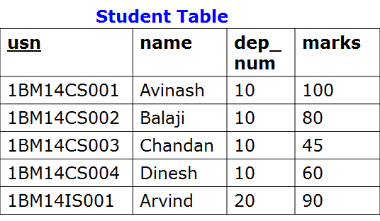

SQL LIKE Operator
Example: Write SQL statement to list the names starting with letter “A” from following student table.

Slide 41

SQL LIKE Operator
Write SQL statement to list name of the students whose names end with letter ‘h’?

Slide 42

SQL LIKE Operator
Write SQL statement to list name of the students whose names are having ‘in’ in their names

Slide 43

SQL LIKE Operator
Question
Write SQL statement to list name of the students whose names
start with letter ‘A’ or ‘B’

Slide 44

SQL LIKE Operator
Write SQL statement to list name of the students whose third letter in the name is ‘a’ .

Slide 45
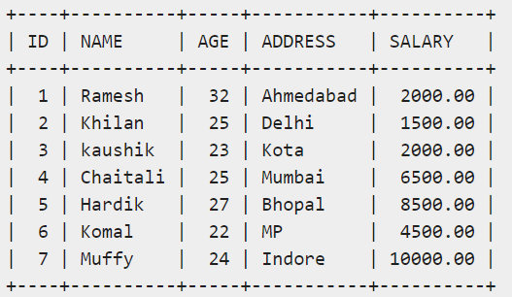
DISTINCT
The SQL DISTINCT keyword is used in conjunction with the SELECT statement to eliminate all the duplicate records and fetching only unique records
select distinct sal
from customer;

Slide 46
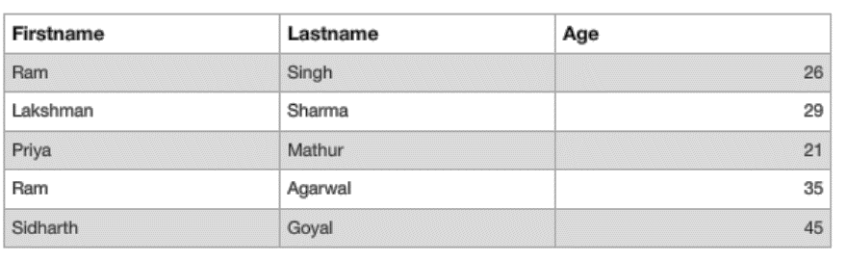
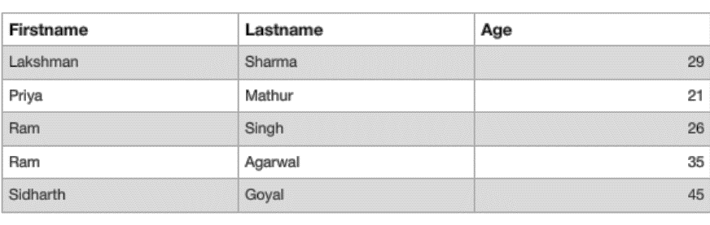
ORDER BY
To sort the data of specific fields in an ordered way
it is used to sort the result-set in ascending or descending order.
SELECT * FROM Data ORDER BY Firstname;

Slide 47
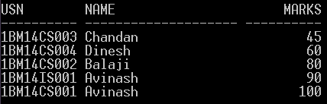
SQL select statement: Order By
Student Table
usn | name | dep_num | marks
1BM14CS001 | Avinash | 10 | 100
1BM14CS002 | Balaji | 10 | 80
1BM14CS003 | Chandan | 10 | 45
1BM14CS004 | Dinesh | 10 | 60
1BM14IS001 | Avinash | 20 | 90

Slide 48
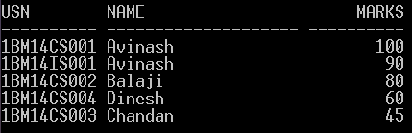
Order By
Student Table
usn | name | dep_num | marks
1BM14CS001 | Avinash | 10 | 100
1BM14CS002 | Balaji | 10 | 80
1BM14CS003 | Chandan | 10 | 45
1BM14CS004 | Dinesh | 10 | 60
1BM14IS001 | Avinash | 20 | 90

Slide 49
SQL select statement: Order By
Student Table
usn | name | dep_num | marks
1BM14CS001 | Avinash | 10 | 100
1BM14CS002 | Balaji | 10 | 80
1BM14CS003 | Chandan | 10 | 45
1BM14CS004 | Dinesh | 10 | 60
1BM14IS001 | Avinash | 20 | 90
Question
List usn, name of the students who belong to department number 10 ordered by ascending order of their marks ?
Notes:
List usn, name of the students who belong to department number 10 ordered by ascending order of their marks ?

Slide 50
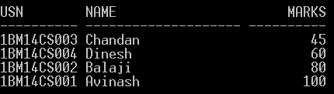
SQL select statement: Order By
Student Table
usn | name | dep_num | marks
1BM14CS001 | Avinash | 10 | 100
1BM14CS002 | Balaji | 10 | 80
1BM14CS003 | Chandan | 10 | 45
1BM14CS004 | Dinesh | 10 | 60
1BM14IS001 | Avinash | 20 | 90
Notes:
List usn, name of the students who belong to department number 10 ordered by ascending order of their marks ?

Slide 51
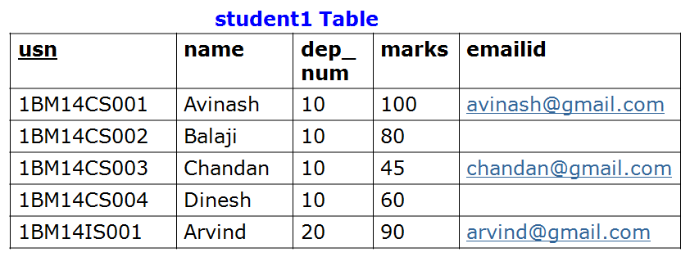
SQL UPDATE Statement
The UPDATE statement is used to update existing records in a table.
SQL UPDATE Syntax
UPDATE table_name
SET column1=value, column2=value2,...
WHERE some_column=some_value
update student1
set emailid=‘dinesh@gmail.com’
where name=‘Dinesh’;

Slide 52
SQL DELETE Statement
The DELETE statement is used to delete rows in a table.
SQL DELETE Syntax
DELETE FROM table_name
WHERE some_column=some_value
delete from student1
where usn=‘1BM14IS001’;

Slide 53
Aggregate Functions in SQL
SQL aggregate functions return a single value, calculated from values in a column.
Useful aggregate functions:
AVG() - Returns the average value
COUNT() - Returns the number of rows
MAX() - Returns the largest value
MIN() - Returns the smallest value
SUM() - Returns the sum

Slide 54

Aggregate Functions in SQL
The AVG() function returns the average value of a numeric column.
Syntax
SELECT AVG(column_name) FROM table_name
Find average marks of all the students in the class.

Slide 55
Aggregate Functions in SQL
SQL COUNT() Function
The COUNT() function returns the number of rows that matches a specified
criteria.
SQL COUNT (column_name) Syntax
The COUNT(column_name) function returns the number of values (NULL
values will not be counted) of the specified column:
SELECT COUNT(column_name) FROM table_name
SQL COUNT(*) Syntax
The COUNT(*) function returns the number of records in a table:
SELECT COUNT(*) FROM table_name
SQL COUNT(DISTINCT column_name) Syntax
The COUNT(DISTINCT column_name) function returns the number of
distinct values of the specified column:
SELECT COUNT(DISTINCT column_name) FROM table_name

Slide 56

Aggregate Functions in SQL
SQL COUNT(*) Syntax
The COUNT(*) function returns the number of records in a table. This includes NULL values and duplicates.
.
Find total number of records in the above
student table

Slide 57

Aggregate Functions in SQL
SQL COUNT(*) Syntax
The COUNT(*) function returns the number of records in a table. his includes NULL values and duplicates.
Find total number of students who belong to department number 10

Slide 58

Aggregate Functions in SQL
SQL COUNT(column_name) Syntax
The COUNT(column_name) function returns the number of values
(NULL values will not be counted) of the specified column.
Find total number of students who have Email IDs

Slide 59
Max FUNCTION
MAX function is used to find out the record with maximum value among a record set. MIN function is used to find out the record with minimum value among a record set
Select MAX (marks)
From student;
Select MIN (marks)
From student;

Slide 60
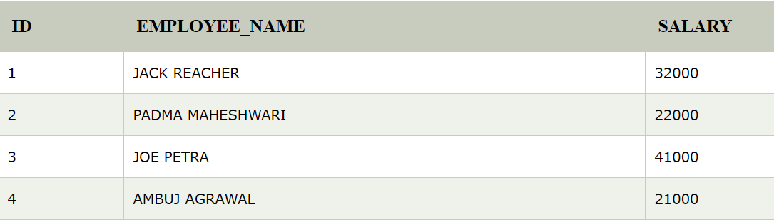
SUM Function
It is used in a SQL query to return summed value of an expression.
SELECT SUM (salary) AS "Total Salary"
FROM employees
WHERE salary > 20000;

Slide 61
Aggregate Functions in SQL
What will be the out put of following SQL queries ?

Slide 62
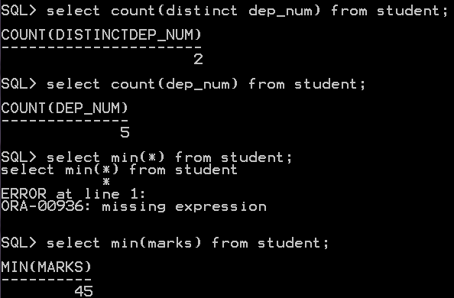
Aggregate Functions in SQL

Slide 63
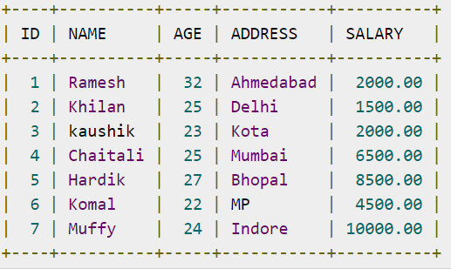
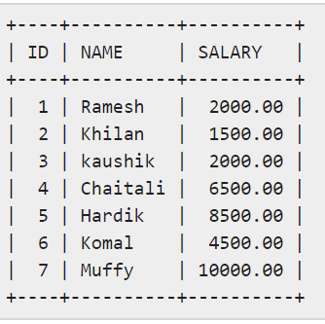
Exercise
Write a query to select ID, Name and Salary fields of the customers available in CUSTOMERS table
select ID,NAME,SALARY
from CUSTOMERS;

Slide 64
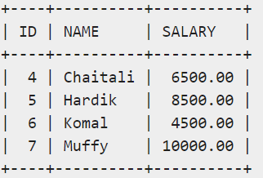
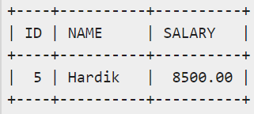
Exercise
Write a query to select ID, Name and Salary fields from the CUSTOMERS table, where the salary is greater than 2000
Select ID, NAME, SALARY
From CUSTOMERS
Where SALARY>2000;
Write a query to select ID, Name and Salary fields from the CUSTOMERS table for a customer with the name Hardik
Select ID, NAME, SALARY
From CUSTOMERS
Where NAME=“Hardik”;

Slide 65
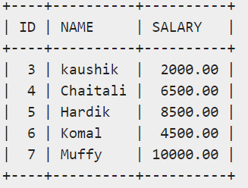
Exercise
Write a query to select ID, Name and Salary fields from the CUSTOMERS table, where the salary is greater than 2000 OR the age is less than 25 years.
Select ID, NAME, SALARY
From CUSTOMERS
Where SALARY>2000 OR AGE<25;

Slide 66
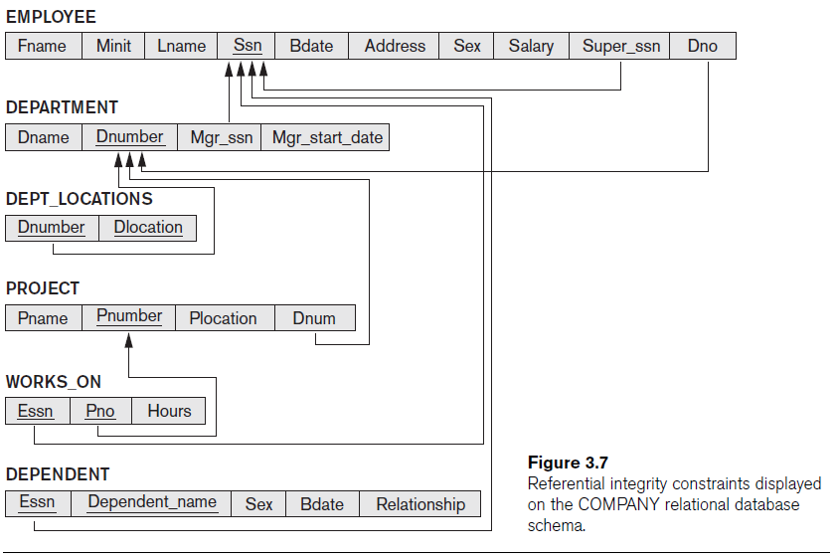
Example
Recall Employee example:

Slide 67
Basic SQL Retrieval Queries
All retrievals use SELECT statement:
SELECT <return list>
FROM <table list>
[ WHERE <condition> ] ;
where
<return list> is a list of expressions or column names whose values are to be retrieved by the query
<table list> is a list of relation names required to process the query
<condition> is a Boolean expression that identifies the tuples to be retrieved by the query
Example
SELECT title, year, genre
FROM Film
WHERE director = 'Steven Spielberg' AND year > 1990;
Omitting WHERE clause implies all tuples selected.

Slide 68
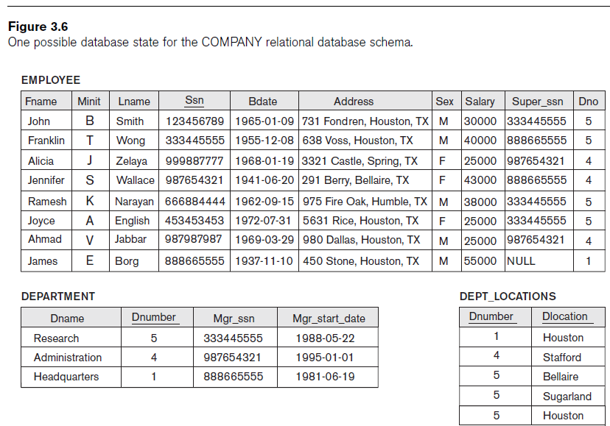
Sample Tables

Slide 69
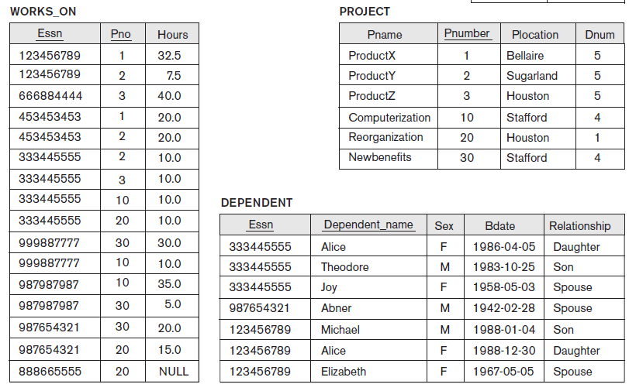

Slide 70
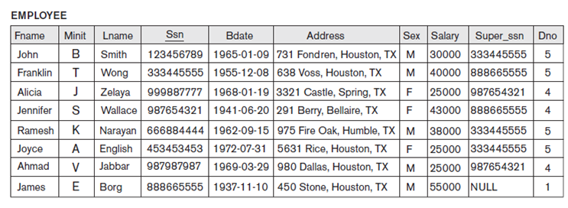
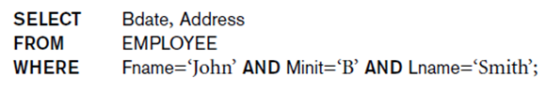

Slide 71
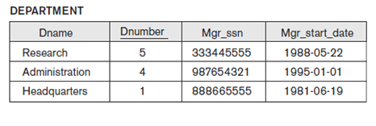
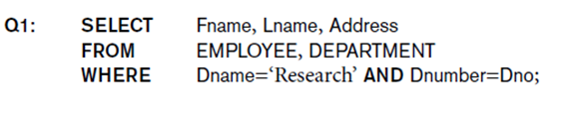

Slide 72
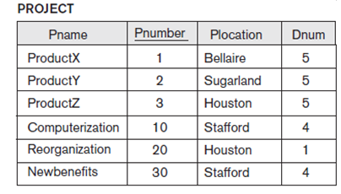

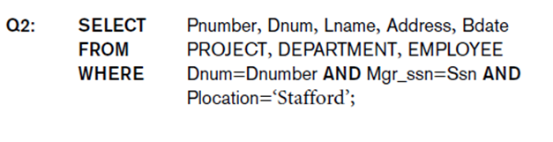

Slide 73
https://www.javatpoint.com/dbms-sql-command

